Slide 1
Sequence Diagrams

Slide 2
Outline
The Requirements Model and the Analysis model
Importance of Sequence Diagrams
Rules of sequence diagrams
Use Cases and Sequence Diagrams
The System Sequence Diagrams
The Vending Machine Example
Other Examples

Slide 3
The Requirements Model and the Analysis Model
The Requirements
Elicitation
Process
Functional/
Nonfunctional
Requirements
Use Case Diagrams/
Sequence Diagrams
(the system level)
The Object-Oriented
Analysis
Process
Static Analysis
Dynamic Analysis
- Class Diagrams
- State Diagrams/
Refined Sequence
Diagrams (The object
level)

Slide 4
Importance of Sequence Diagrams
Depict object interactions in a given scenario identified for a given Use Case
Specify the messages passed between objects using horizontal arrows including messages to/from external actors
Time increases from Top to bottom

Slide 5
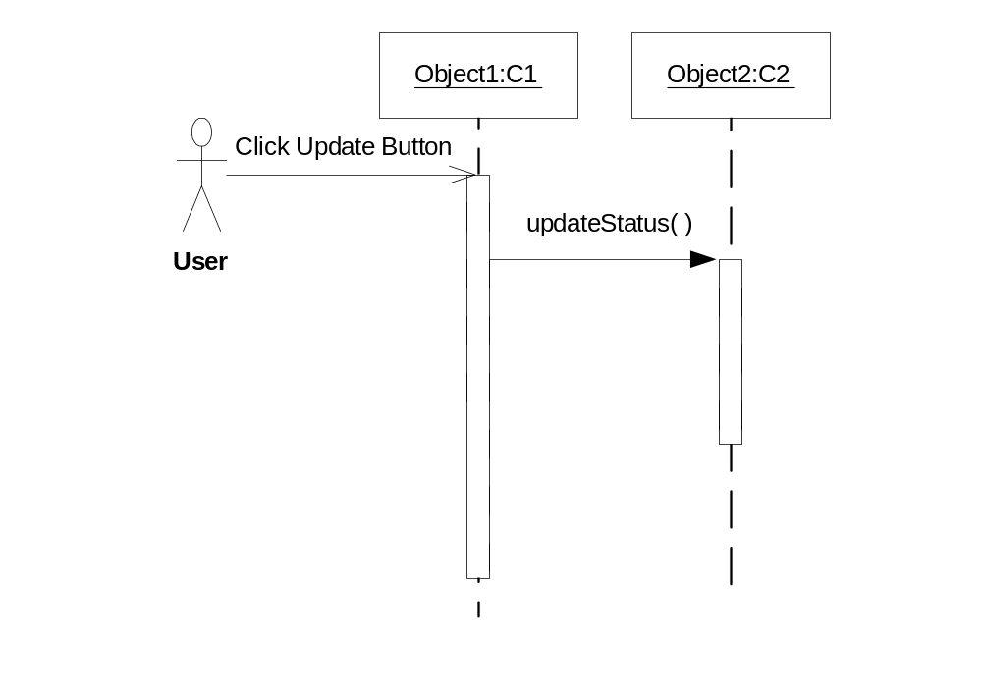
Rules of Sequence Diagrams
Sequence Initiation

Slide 6
Rules of Sequence Diagrams
Identify objects needed to support use case, determine sequence of internal events following the external initiating event
Diagrams that are not initiated with an external actor represent only a partial sequence
Partial sequence diagrams should clearly identify the actor initiated sequence diagrams from which they are launched

Slide 7
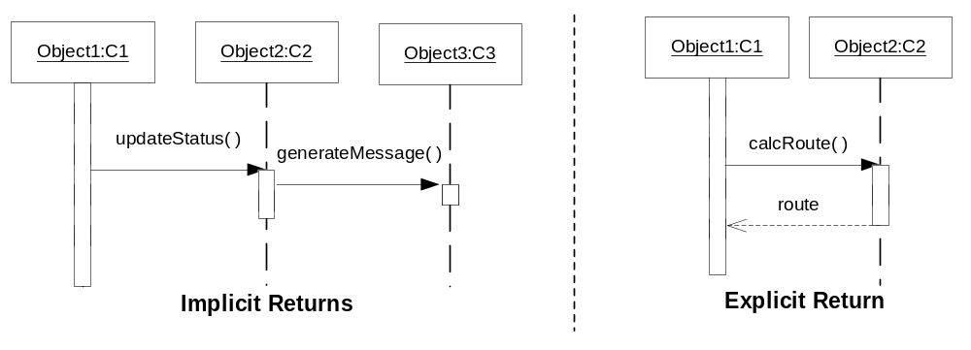
Rules of Sequence Diagrams
Messages specified on interactions can be synchronous or asynchronous
Synchronous call

Slide 8
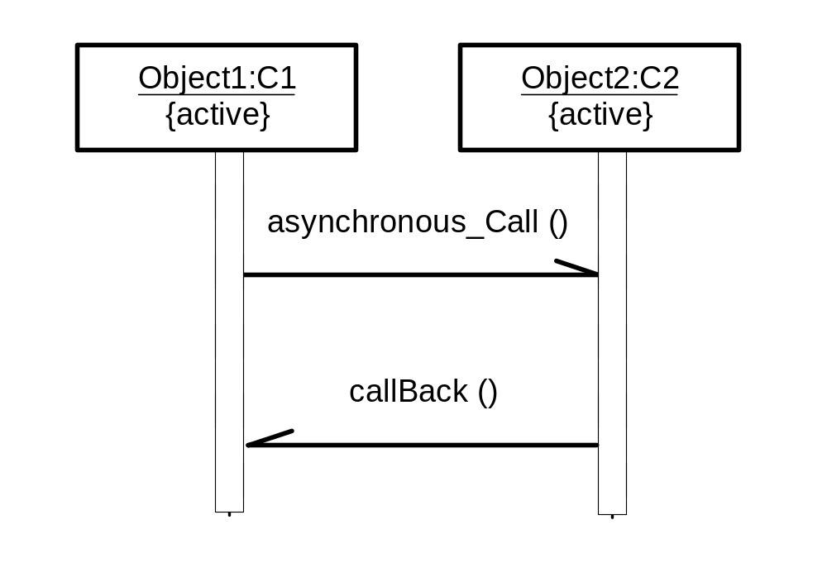
Rules of Sequence Diagrams
Asynchronous call

Slide 9
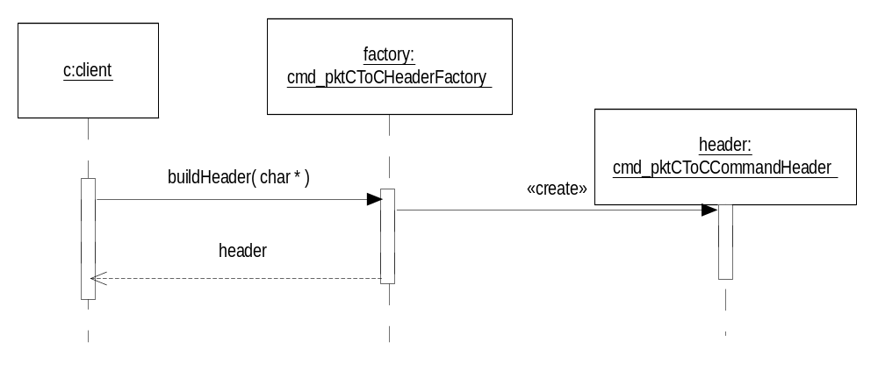
Rules of Sequence Diagrams
Display operation names on call arrows

Slide 10
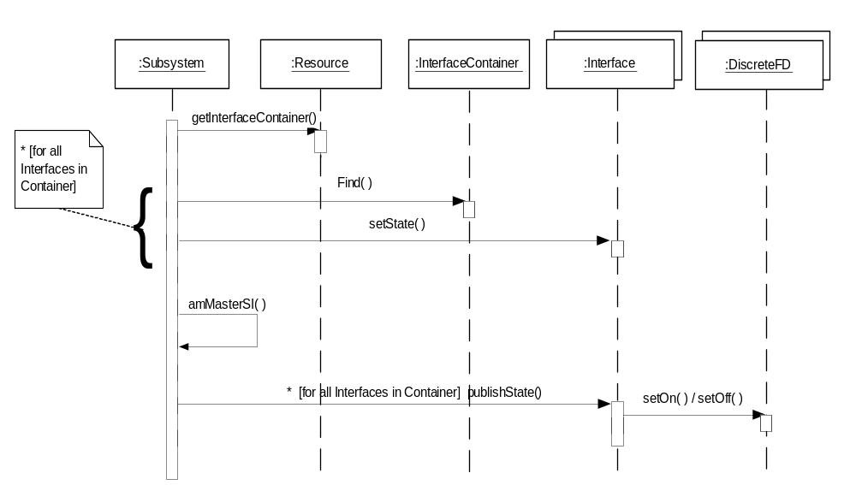
Rules of Sequence Diagrams
Compound and Simple Iteration

Slide 11
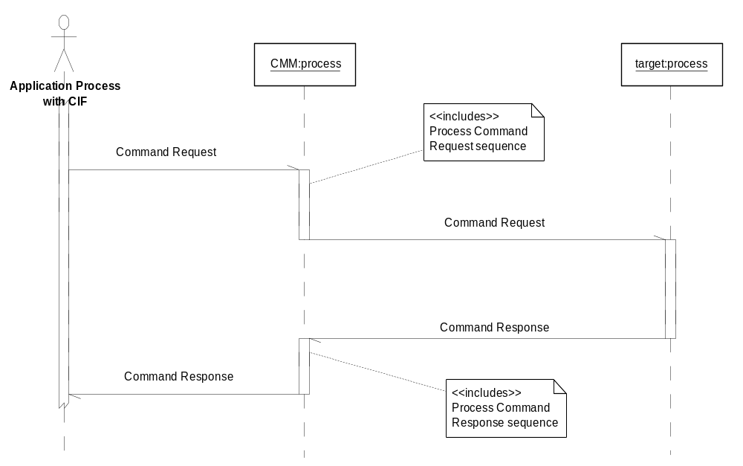
‘included’ sequence diagrams

Slide 12
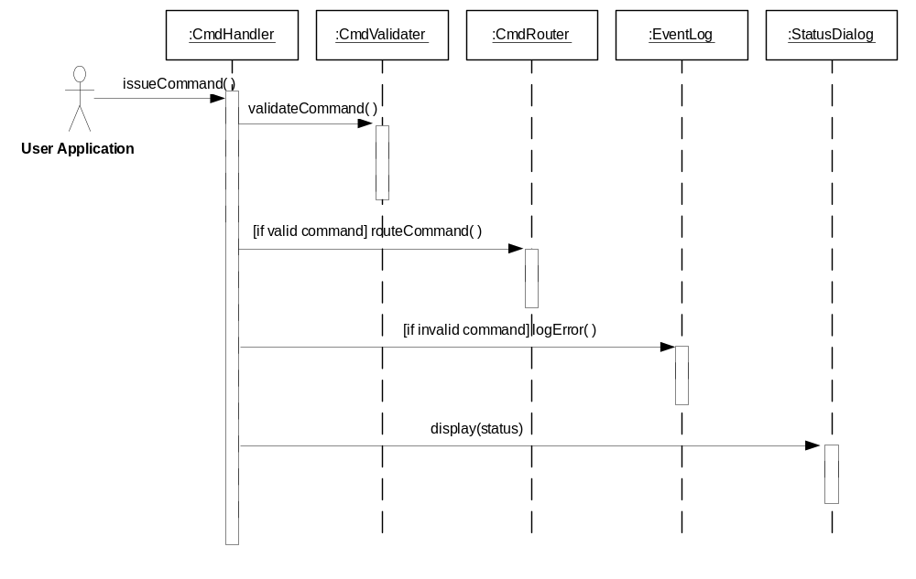
Showing alternate behavior in a sequence diagram

Slide 13
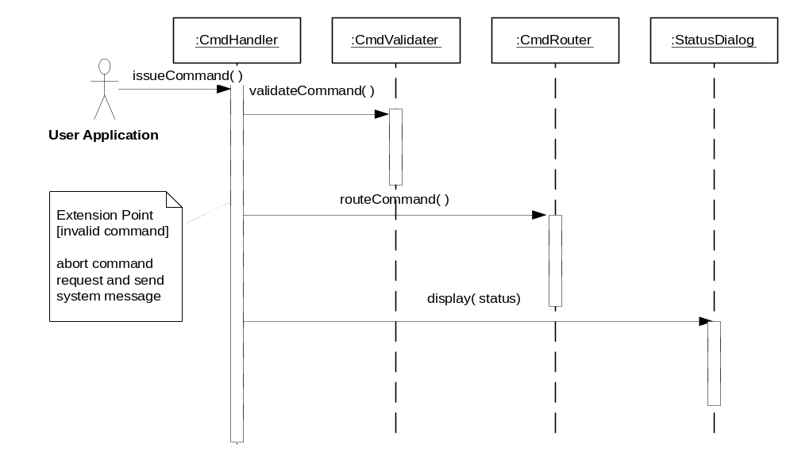
Showing Extension Point

Slide 14
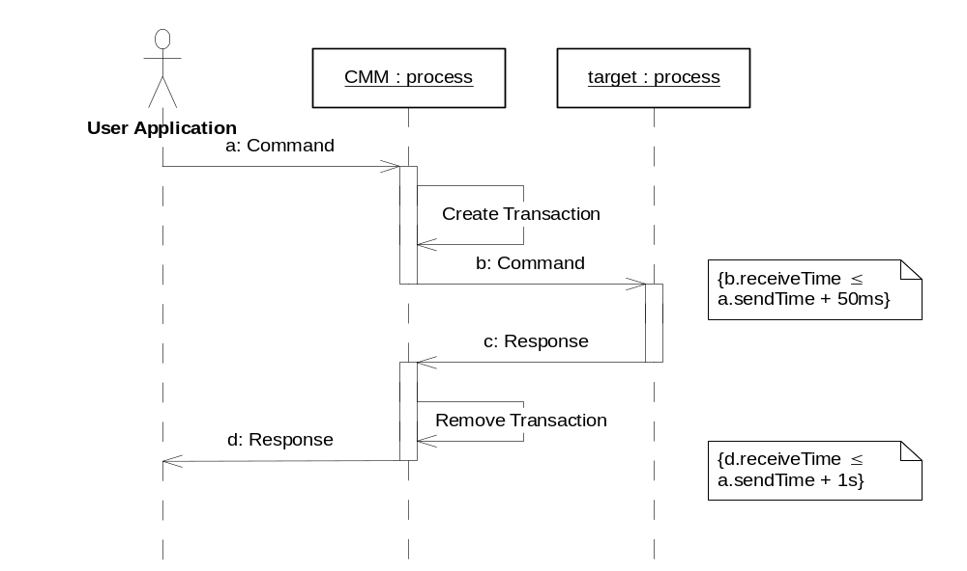
Specifying Timing Requirements

Slide 15
Requirements Elicitation Process
Step 4. Refining Use Cases using
System Sequence Diagrams
System sequence diagrams establish the dynamic behavior in terms of key scenarios of the system for each use case
The system sequence diagram models a scenario of the system interactions with the environment for a given use case
Input/output events are clearly identified in each sequence diagram,
The State of the system before and after each event are also depicted
Different diagrams model scenarios with the normal flow of events and the abnormal flow of events

Slide 16
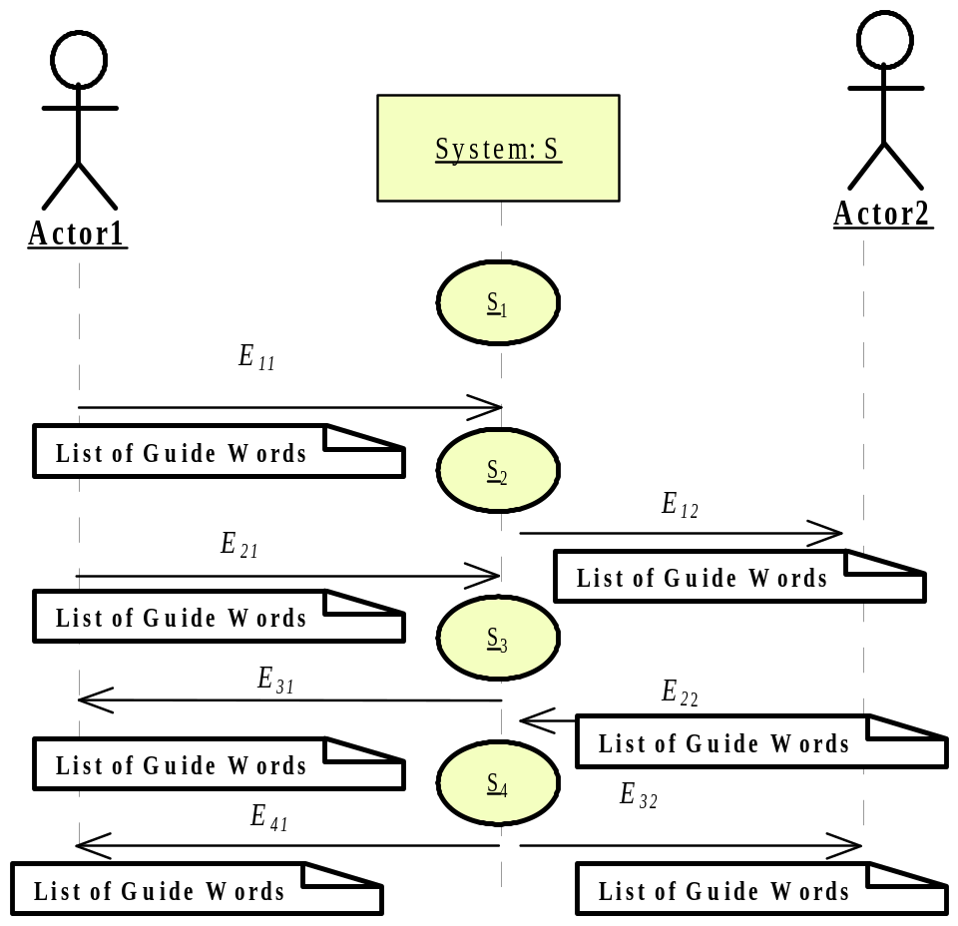
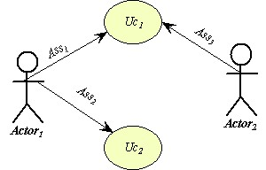
Sequence Diagrams and Use Cases
System Sequence Diagram
The use case diagram
Of system S
The sequence diagram of use case UC1 for system S

Slide 17
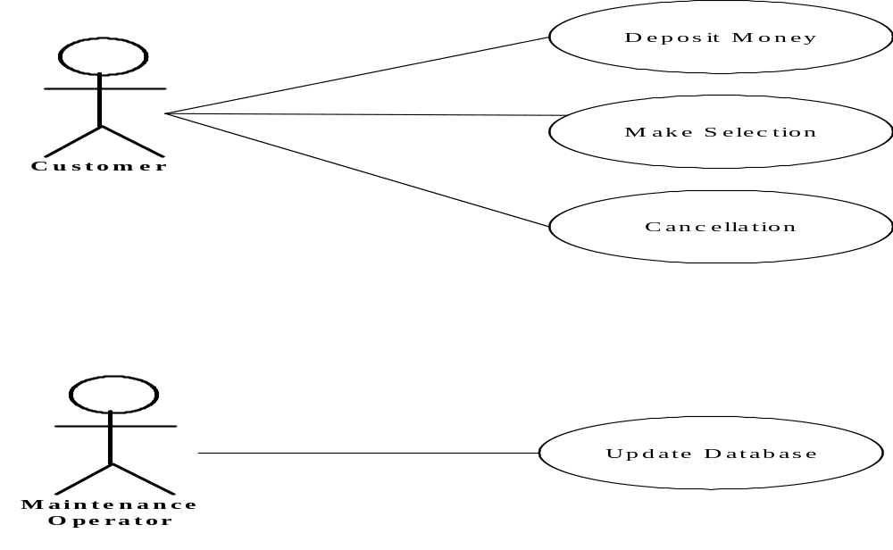
Example: Use Case Diagram of the Vending Machine

Slide 18
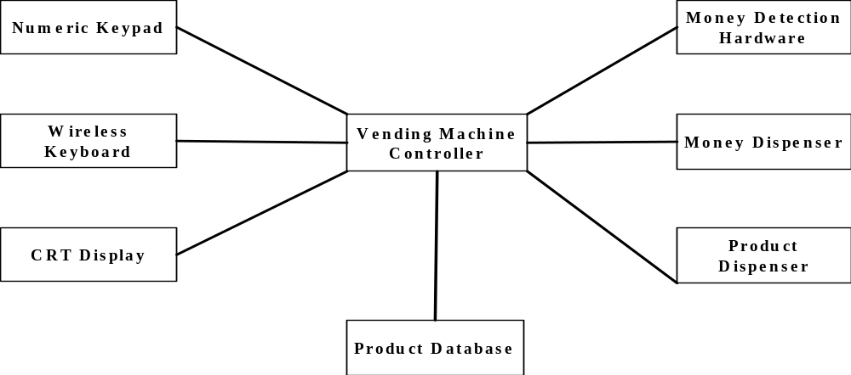
Requirements Elicitation Process
Step 6. Identify Initial Analysis Objects- The Initial Object-Model
<<actor>>
<<actor>>
<<actor>>
<<actor>>
<<actor>>
<<actor>>
Designate the Actor objects with the <<actor>> stereotype
above the object label

Slide 19
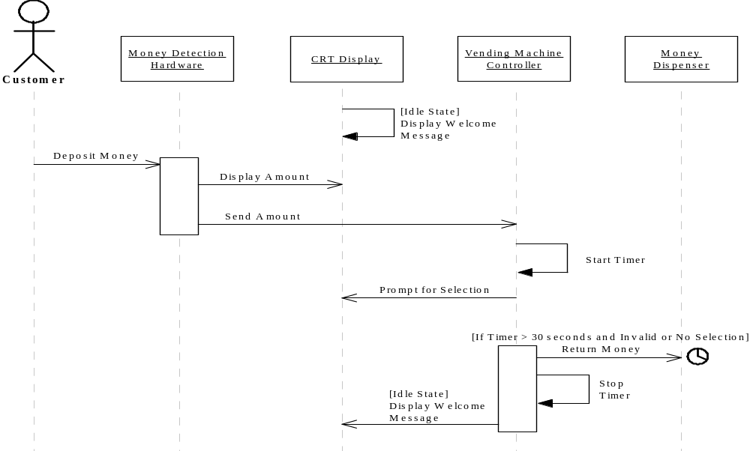
System Sequence Diagram for Deposit Money Use Case

Slide 20
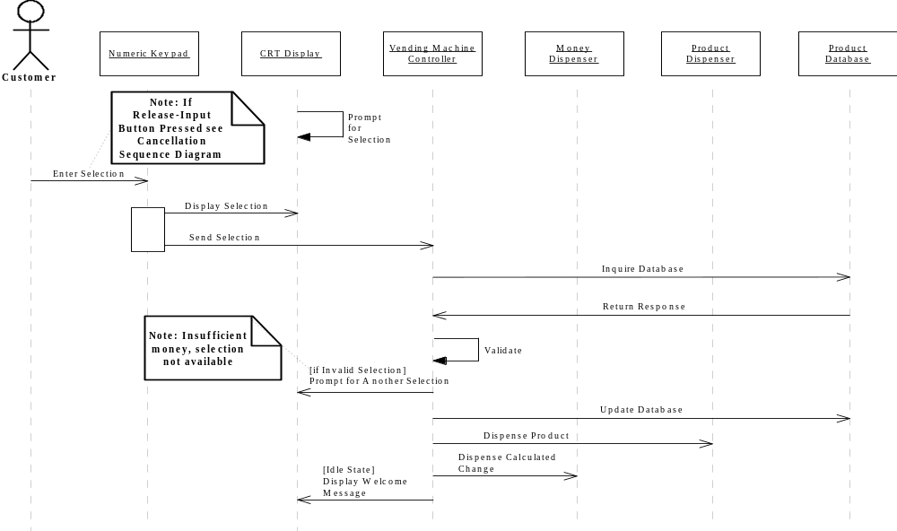
System Sequence Diagram for Make Selection Use Case

Slide 21
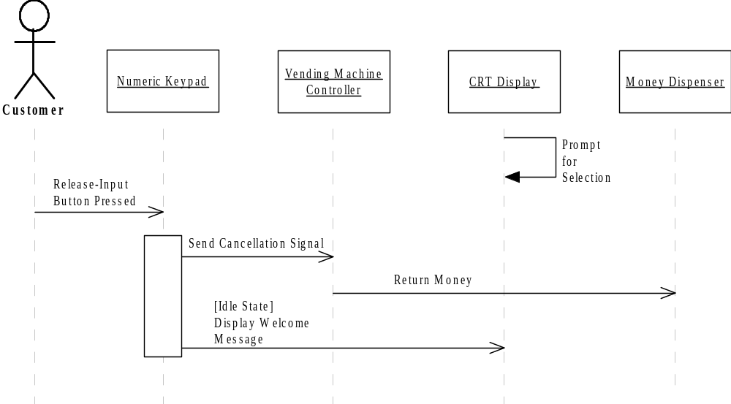
System Sequence Diagram for Cancellation Use Case

Slide 22
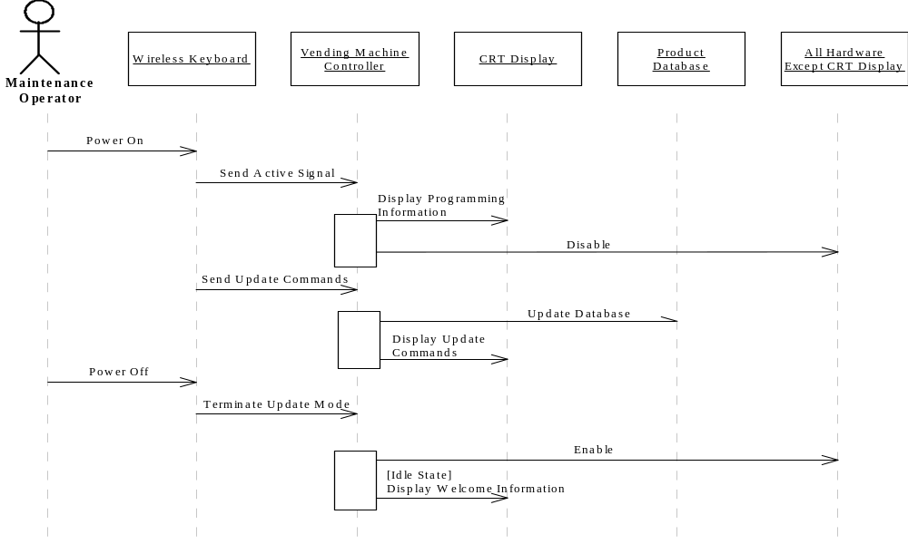
System Sequence Diagram for Update Database Use Case

Slide 23
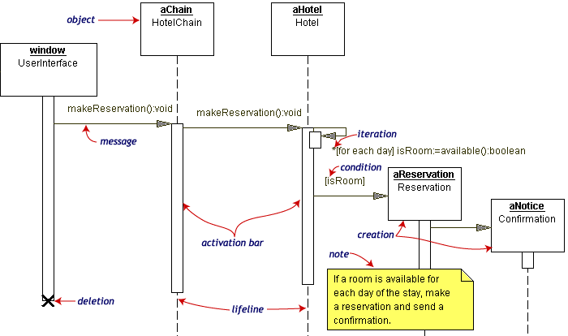
Other Examples of Sequence Diagrams

Slide 24
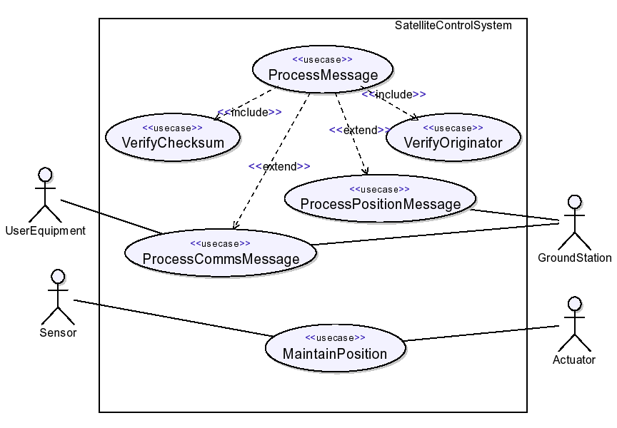
A Simple Example of Using UML2
EXAMPLE: SATELLITE CONTROL SYSTEM

Slide 25
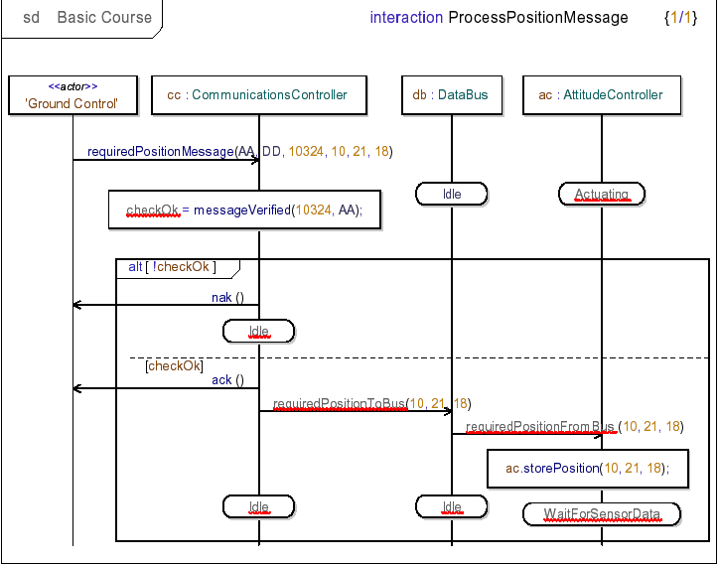
A Simple Example Using UML2
SATELLITE CONTROL SYSTEM Architectural behavior

